Slide 1

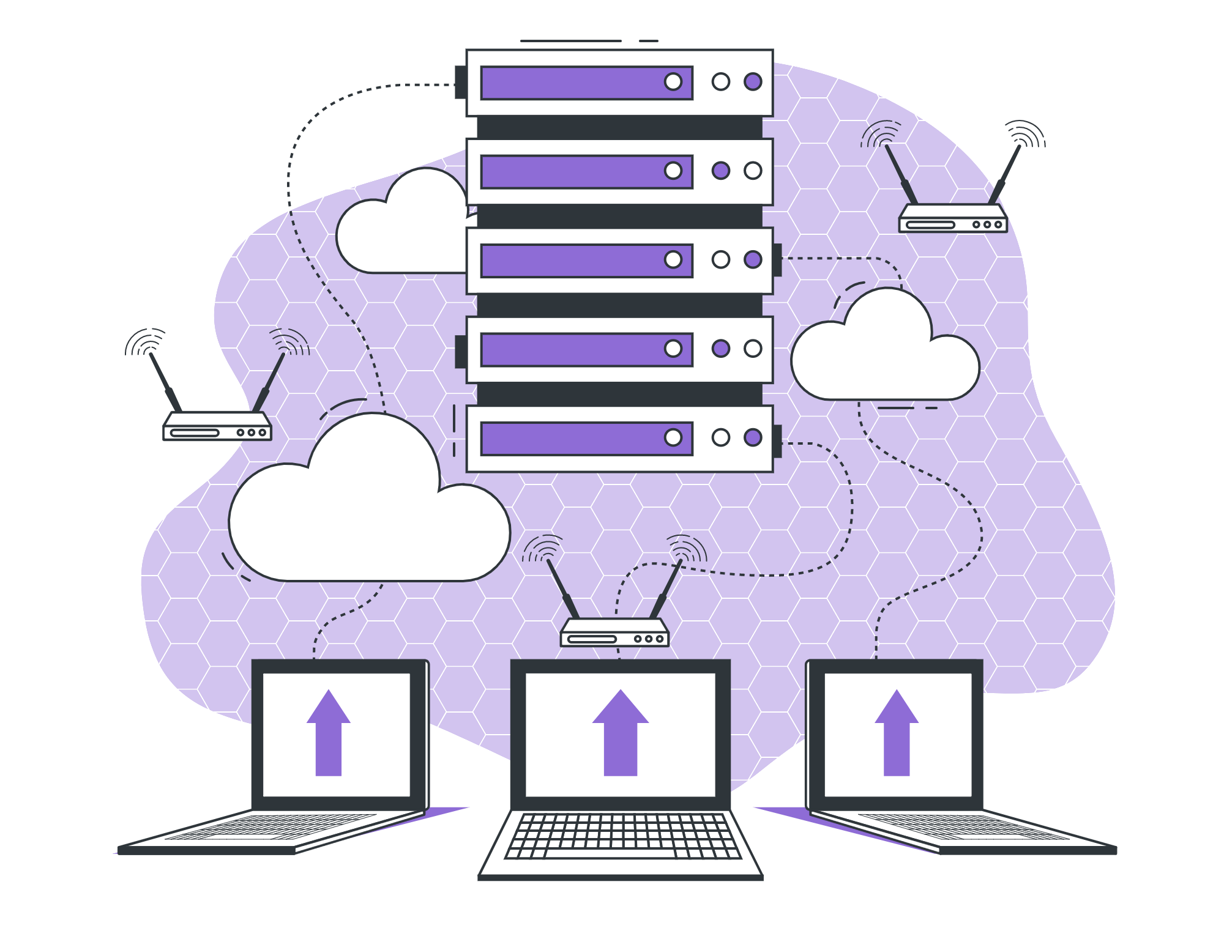
Types of Relationships

Slide 2

Lecture Checklist
Importance of Relationships in RDBMS.
Types of Relationships.

Slide 3

Importance of Relationships in RDBMS
The concept of relationships in RDBMS is inspired by daily life human relationships.

Slide 4
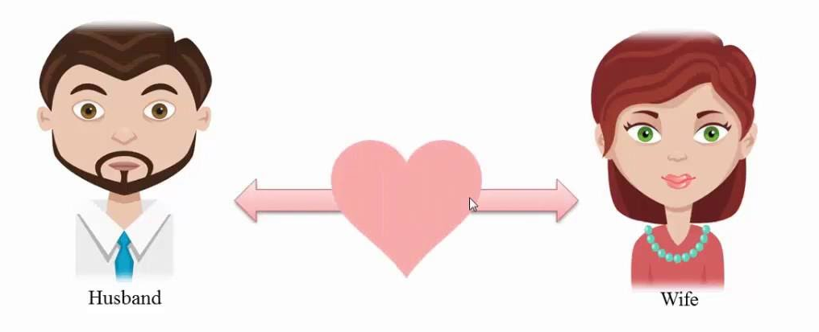
Types of Relationships
One to One relationship
One to One

Slide 5

Types of Relationships
One to One relationship: Citizens & Passport Number

Slide 6
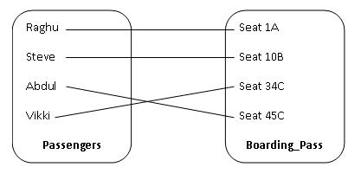
Types of Relationships
One to One relationship

Slide 7

Types of Relationships
One to Many relationship: Country & Residents

Slide 8

Types of Relationships
One to Many relationship

Slide 9
Types of Relationships
Many To One relationship: Country & Residents

Slide 10
Types of Relationships
Many to One relationship

Slide 11

Types of Relationships
Many To Many relationship: Tinder

Slide 12
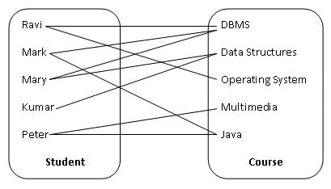
Types of Relationships
Many to Many relationship

Slide 13
THANK YOU

